Slide 1
PUBLIC SCHOOLS OF NORTH CAROLINA
STATE BOARD OF EDUCATION
DEPARTMENT OF PUBLIC INSTRUCITON
301 North Wilmington Street, Raleigh, 27601
Please note that effective January 26, 2010, all North Carolina public school students will be taxed monthly for the use of their school locker. This tax is non-negotiable, and any student refusing to pay the tax will loose their locker privileges. The funds collected will assist in the proposed renovation of the State Superintendent’s office, as well as the purchase of new office furniture for Board of Education employees working at 301 N. Wilmington Street in Raleigh. The tax will be $4.00 per month, a fee that we feel is quite reasonable. While we understand this may be a controversial issue, it is important all students and families recognize that we have no other choice due to recent budget cuts to our state education budget. We trust that every North Carolina student and family will do their part to assist in this matter.

Slide 2
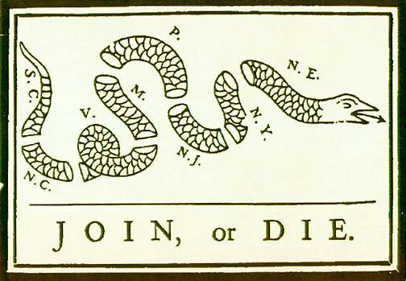
Causes of the American Revolution
& Self Government in the Colonies

Slide 3
1660: The Navigation Acts
British Action:
– Designed to keep
trade in England and
support mercantilism
– Colonists could only
trade goods with England
– All colonial ships must
stop in a British harbor
before going to
another country
Colonial Response:
– Ignored them (profitable to trade with other countries)
– Salutary Neglect
(relaxed enforcement
for continued loyalty

Slide 4
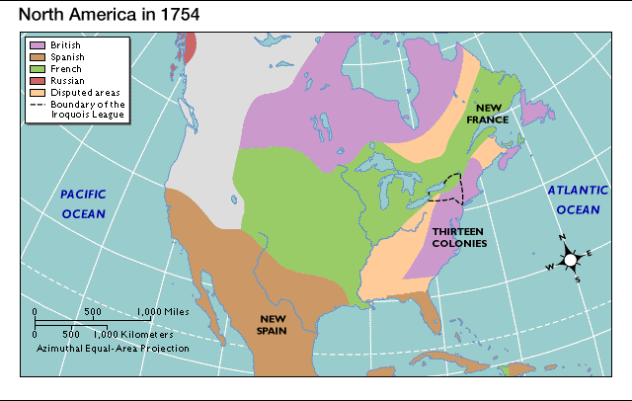
The French and Indian War
French empire collided w/ British empire
Competing over the Ohio River Valley

Slide 5
Treaty of Paris
Proclamation Line of 1763
Britain claimed land east of the Mississippi River
Proclamation Line: banned all settlement west of Appalachian Mts. (to ease tensions w/ N.A.)
Increased Independent Spirit

Slide 6
Writs of Assistance
British Action:
– Designed to crack down on colonial smuggling
– Search warrants that allowed British officials to search any place, seize anything at any time
Colonial Response:
– Outraged the merchants of Boston

Slide 7
Britain’s New Policy for Colonial
America
New Policy had three basic objectives:
– Place the colonies under strict British political and economic control
– Make the colonies respect and obey British laws
– Make the colonies pay their part in maintaining the British Empire

Slide 8
1764: Sugar Act
British Action:
– Cut the tax on molasses but raised it on other goods such as textiles, wine, coffee, indigo, and sugar
– Strengthened Vice Admiralty courts, Cases decided by a single judge, not a jury
Colonial Response:
– First time a tax had been passed to raise revenue rather than regulate trade
– Colonial merchants protested the increased duties

Slide 9
1765: Quartering Act
British Action:
– Purpose to keep troops in the colonies and reduce the cost
– Colonists had to keep troops in their homes
Colonial Response:
– Colonists did not get along with army and did not want them there permanently

Slide 10
1765: The Stamp Act
British Action:
– Taxed all documents, newspapers, and playing cards by forcing colonists to place a special stamp on the items
Colonial Reaction:
– Sons of Liberty
– Harassed stamp distributors
– Boycotted (a collective refusal to use, buy or deal with) English goods
– Stamp Act Congress issued a Declaration of Rights and Grievances (9 legislatures)

Slide 11
Stamp Act: British Response
Parliament repealed the Stamp Act
– Boycotts so successful not one stamp was ever sold
Declaratory Act – asserted Parliament’s right to make laws that “bind the colonies in all cases whatsoever

Slide 13
1767: The Townshend Acts
British Action:
– Put tax on goods such as paper, glass, paint, and tea
– Revenue raised would be to pay salaries of British officials in the colonies
Colonial Reaction
– Organize new boycott of goods
– Protest “No taxation without representation”
– Demonstrations and clashes between colonists and soldiers
– Women get involved in protests

Slide 14
Press Release
Write a press release as if you were a British official explaining why the new British policy of strict control and taxation is necessary.

Slide 15
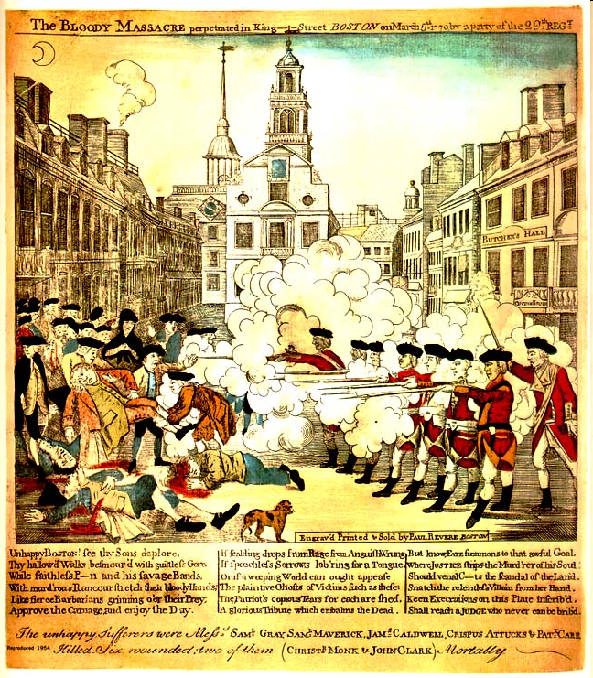
March 3, 1770: The Boston
Massacre

Slide 16
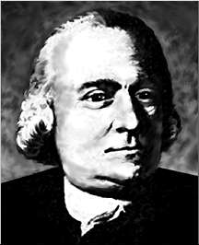
1772: Committees of
Correspondence formed
Started by Samuel Adams
Used to pass information between the colonies
It was a secret organization

Slide 17
1773: Tea Act
Parliament repealed Townshend Acts except for the tax on tea
– In the first year the taxes raised 295 pounds, but the cost of sending British troops to Boston was 170,000 pounds
Allowed the East India Tea Company to sell tea without the tax to make it cheaper
– Had been hurt badly by the boycotts

Slide 18
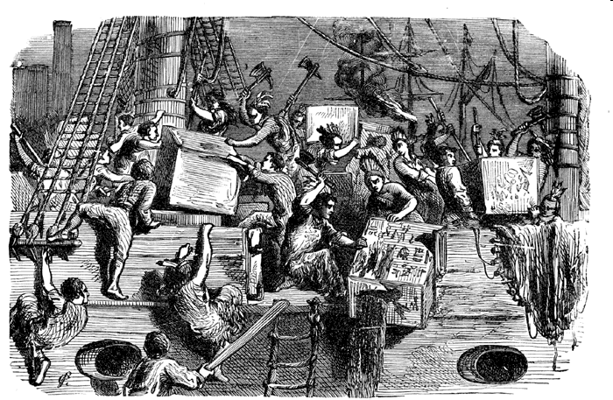
Dec. 16, 1773: Boston Tea
Party

Slide 19
Spring 1774: The Intolerable Acts
Designed to punish the colonists for Tea Party
Closed the port at Boston
No town meetings allowed in Massachusetts
– Boston under military rule
– Trying to isolate Massachusetts, but only strengthened the colonies unity

Slide 20
1774: First Continental
Congress
Met in Philadelphia
All colonies had representatives except Georgia
Divided on the issue of declaring independence
Sent Declaration of Rights and Grievances to King George III
– Defended colonies’ right to run their own affairs
– Supported the protests in Massachusetts

Slide 21
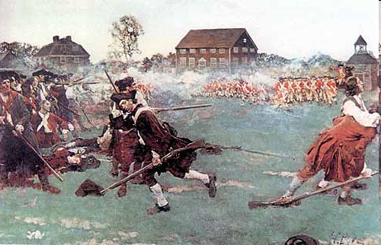
April 19, 1775
Shot heard round the world fired at the Battle of Lexington
Start of the revolutionary war

