Slide 1
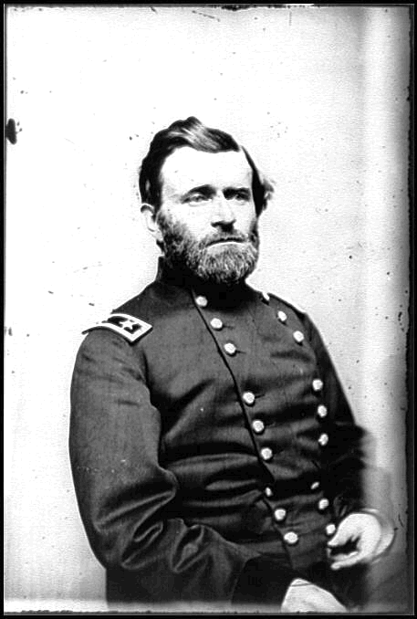
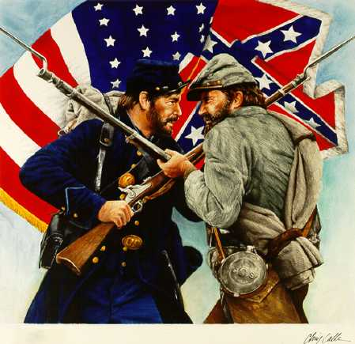
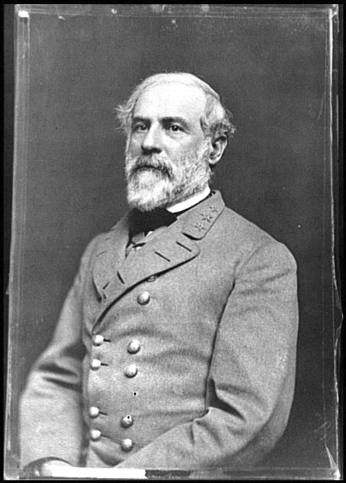
Causes of the Civil War

Slide 2
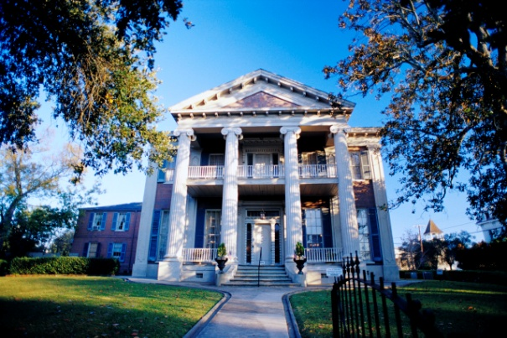
Growing Division in the US
North
Industrialized
Railroads
Telegraph
Trade Unions
Immigrants from Europe
South
Agriculture
Cotton
Yeomen and Tenant Farmers
Plantations
Slavery

Slide 3
Sectionalism
During the 1850s, conflict between different areas of North Carolina increased.
Western areas grew less cotton and wheat and needed fewer slaves.
Eastern areas increased cotton production and needed more slaves.
Sectionalism also effected the US as a whole. North versus South, West versus East

Slide 4
The Cotton Gin
The Cotton Gin (engine) was invented by Eli Whitney
The Cotton Gin separated cotton seeds from the fibers, a job that was previously done by hand.
The invention caused an increase in the production of cotton, which caused an increase in plantations and slavery

Slide 5
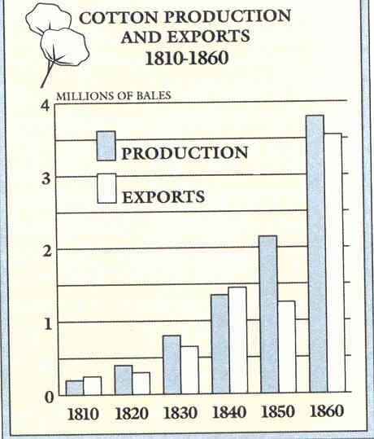

Slide 6
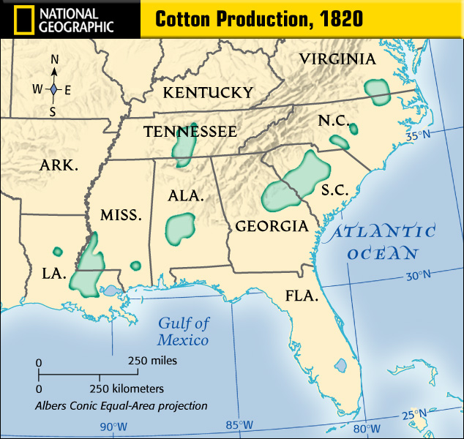


Slide 7
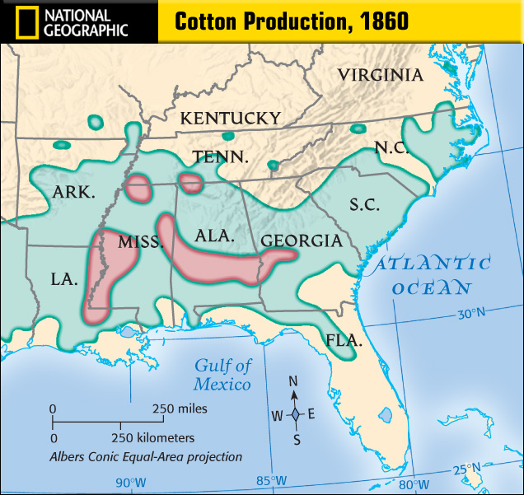
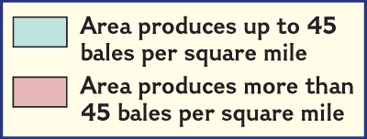

Slide 8
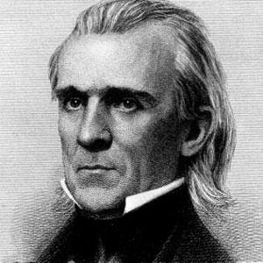
The Compromise of 1850
Manifest Destiny: the belief that the US should control all the land from Atlantic to Pacific.
1844: James K. Polk (from North Carolina)elected President.
Polk annexed (added) Texas to the US. This led to war with Mexico over the land.
Compromise of 1850: allowed California to enter the Union as a free state, introduced Popular Sovereignty (the will of the people), and made a stronger fugitive slave law.
James K. Polk

Slide 9
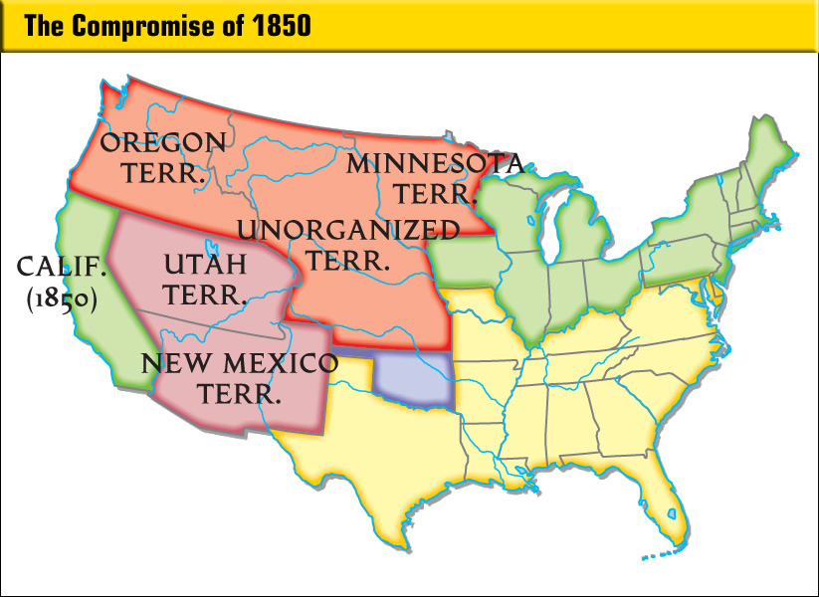
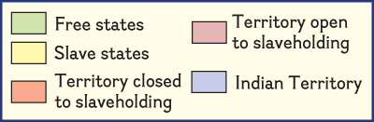

Slide 10
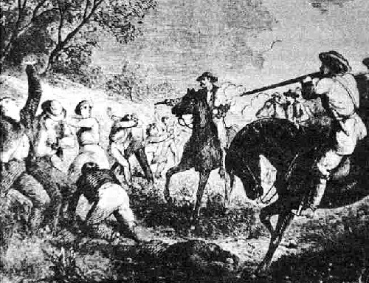
The Kansas-Nebraska Act
Created two northern territories with Popular Sovereignty (people choose whether slavery legal or not)
Opponents of slavery created the Republican Party (yes, the modern Republican Party)
Set off “Bleeding Kansas”. Violence erupts between pro and anti-slavery groups

Slide 11
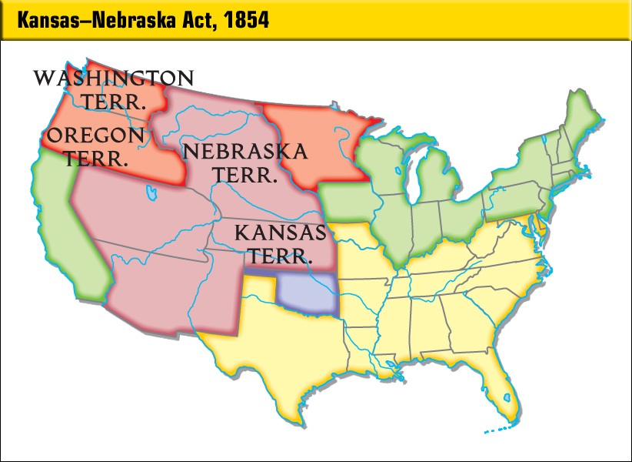

Slide 12
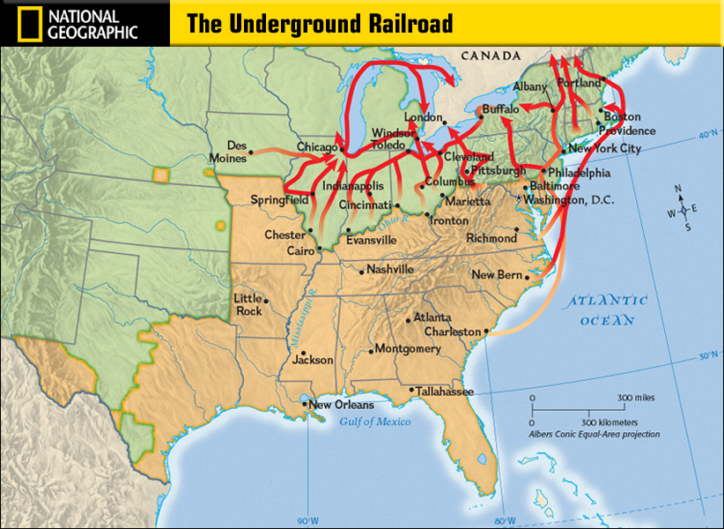
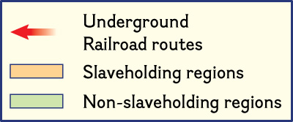

Slide 13
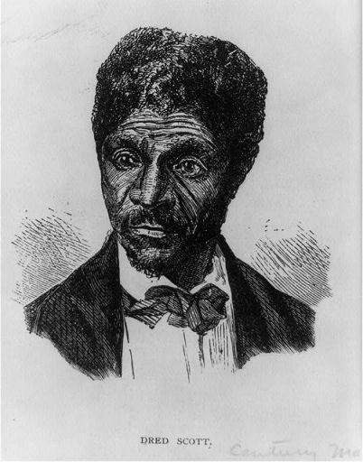
Dred Scott Decision
Dred Scott was a slave taken to a free state, then back to a slave state. He sued for freedom when his master died.
The Supreme Court Ruled:
  1)Dred Scott was not a citizen
  so he cannot sue in court
  2)African Americans had
  no rights
  3)Missouri Compromise was unconstitutional

Slide 14
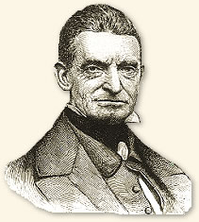
Abolitionists
There were many people opposed to slavery in the North.
Most of these individuals used peaceful means to protest slavery. Frederick Douglas, Sojourner Truth, and William Lloyd Garrison were writers and speakers against slavery.
Harriett Tubman founded the Underground Railroad and helped slaves to freedom.
John Brown advocated violence to end slavery and raided the US military arsenal in Harpers Ferry, VA to steal guns to arm slaves and start a revolt
John Brown

Slide 15
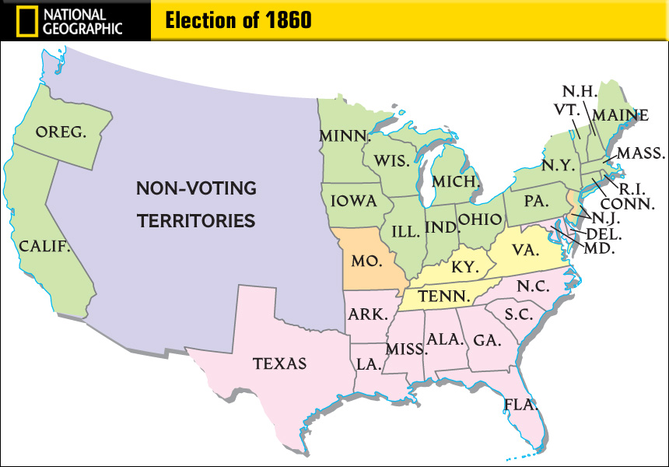
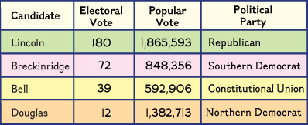

Slide 16
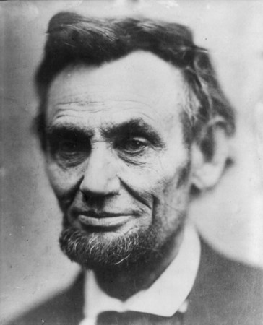
The Failure of Unionism
Abraham Lincoln is elected President in November 1860
Southerners believed that Lincoln planned to free all slaves
South Carolina seceded from the United States in December, 1860
Mississippi, Florida, Alabama, Georgia, Louisiana, and Texas quickly follow
The Confederate States of America formed in Feb. 1861
Jefferson Davis elected President of the CSA

Slide 17
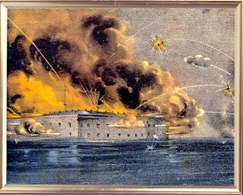
The Failure of Unionism continues
Fort Sumter in Charleston, South Carolina is attacked by Confederate troops
Lincoln calls up 75,000 troops to defend the Union and retake the Confederacy
Virginia, North Carolina, Tennessee, and Arkansas join the Confederacy
in April, 1861
Border States (Maryland, Kentucky,
and Missouri) and West Virginia
vote to stay in the Union

Slide 18
