Slide 1
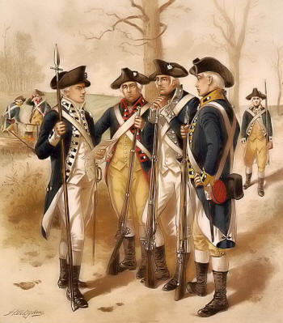
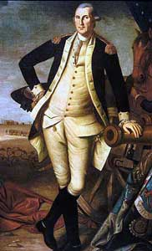
Revolutionary War
Key Events during the Revolutionary War

Slide 2
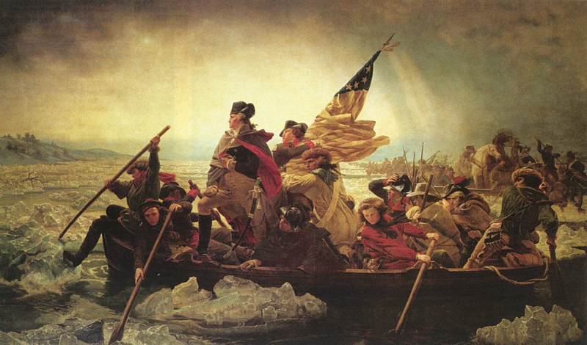
1776
February: Battle of Moore’s Creek Bridge, NC – Patriots defeat the Loyalists
July: Declaration of Independence
Aug/Sept: British defeat Washington’s army and occupy New York
December: Washington crosses the Delaware River and defeats the British at Trenton, NJ
Washington crossing the Delaware River

Slide 3
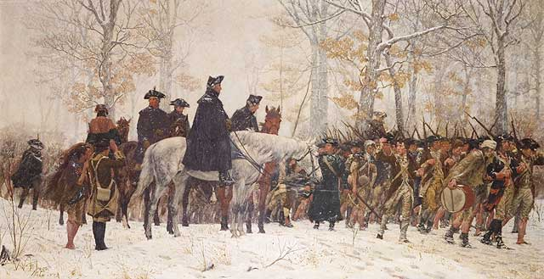
1777
Jan-May : Washington’s army spends winter in New Jersey
Sept: British occupy Philadelphia, PA
Oct: Patriots defeat British at Saratoga, NY
December: Washington’s army spends winter at Valley Forge, PA. Soldiers suffer many hardships.

Slide 4
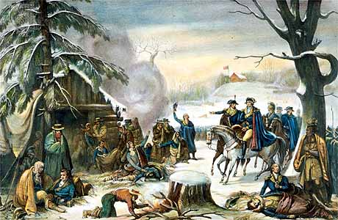
1778
Feb: The US and France sign an Alliance against England. The help of France is vital to the war effort.
June: Washington’s army leaves Valley Forge
Dec: British army occupies Savannah, GA

Slide 5
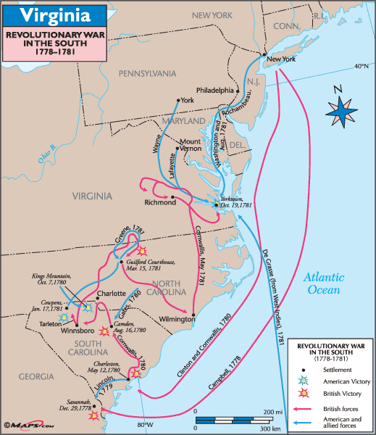
Revolutionary War in the South

Slide 6
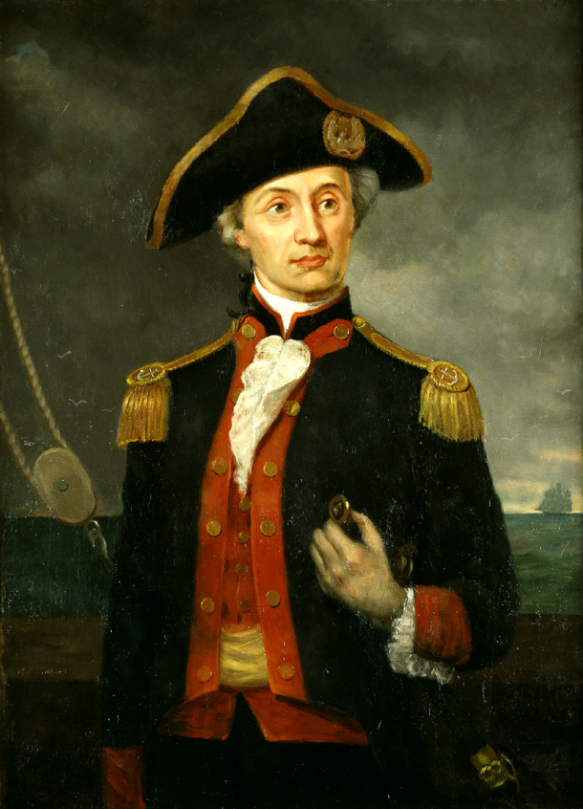
1779
Jan – May: Various indecisive battles in Georgia and South Carolina
June: Spain declares war on England
July: British burn cities in Connecticut
Sept: John Paul Jones begins to capture British ships. America starts to develop a navy.
John Paul Jones

Slide 7
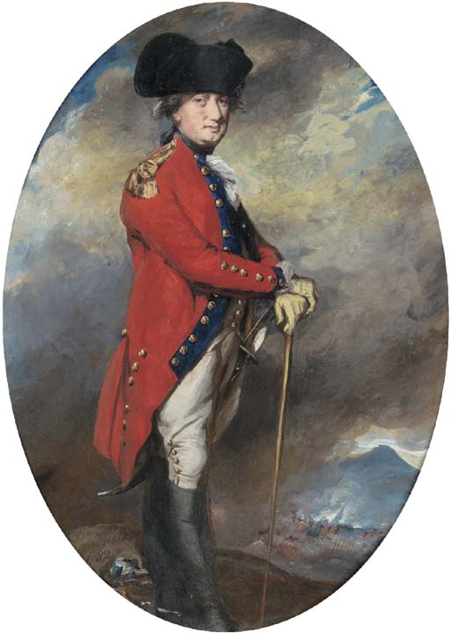
1780
May: British defeat Patriots at Charleston, SC
June : Lord Cornwallis becomes head of the British Army in the South
August: British defeat Patriots badly at Camden, SC
October: British are defeated by the Overmountain Men at Kings Mountain, NC
October: Nathaniel Greene named commander of the Continental Southern Army
Lord Cornwallis

Slide 8
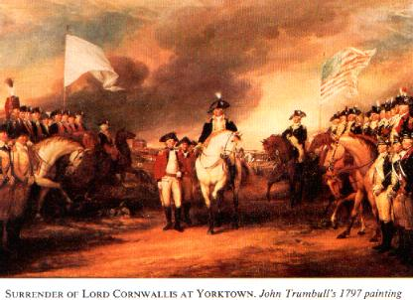
1781
January: British are defeated at Cowpens, SC
March : British defeat General Greene at Guilford Courthouse, NC but they suffer heavy losses.
Sept: French navy drives the British navy away from the coast of Virginia. This traps the British army.
October: British Army led by General Cornwallis is surrounded, and surrenders at Yorktown, VA

Slide 9
Revolutionary War in the South

Slide 10
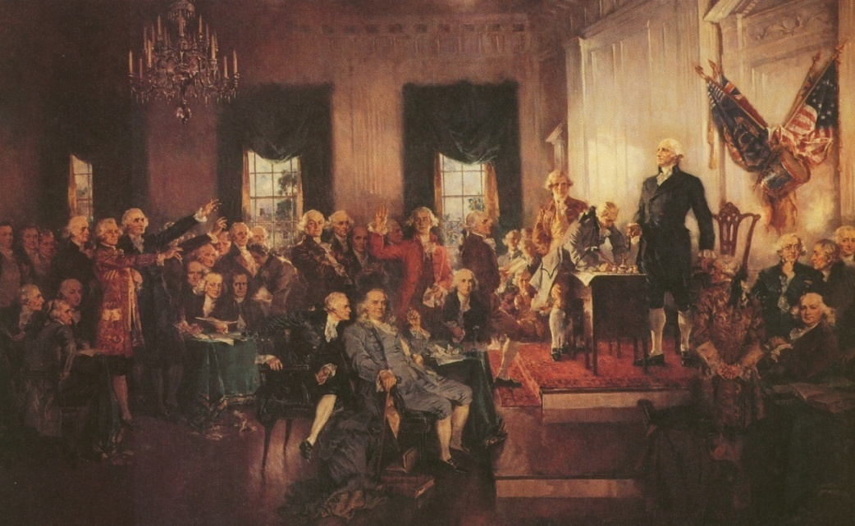
1782- 1788
1782: British evacuate the southern colonies
1783: British sign peace treaty and leave New York. Washington resigns as head of the army
1787: US Constitution signed
1788: Constitution ratified (approved) by the states

